Slide 1
Galaxy NFT Marketplace
Ashton Nikzad, Kazuki Takehashi, & Patrick Thornquist

Slide 2
Executive Summary
Galaxy NFT Marketplace aims to make the entire NFT process simple and fun!
From the beginning minting process, to listing and selling your NFT, to exploring the marketplace and buying other popular NFTs, Galaxy NFT Marketplace is your one-stop shop!

Slide 3
Approach
Learning from the first two group projects, we knew there would be bumps in the road. Going in with this mindset helped us to better prepare for the unexpected, and also to keep our goals within reach.
We began by making an outline of our project, writing the main Solidity code and functions, and then slowly adding page by page in Streamlit. There was constant troubleshooting, but we got through it!

Slide 4
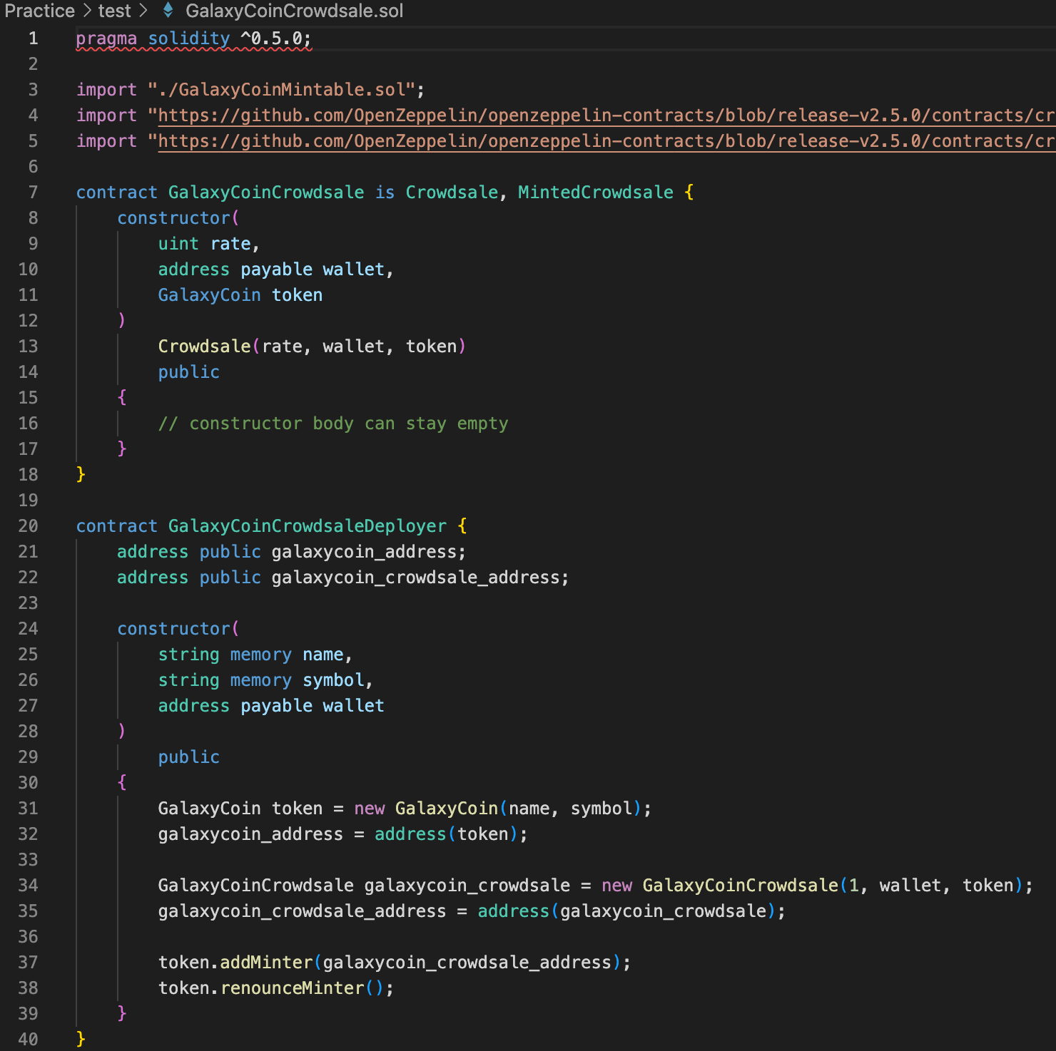
Initial ERC20 plans
Our hopes of creating our own ERC20 Galaxy Coin token were short lived.
We discovered that the version of OpenZeppelin with crowdsale did not work with the version of ERC721 that we were using.
Unable to easily buy/use an ERC20 token with the rest of our project, we quickly abandoned the idea and settled on using ETH.

Slide 5
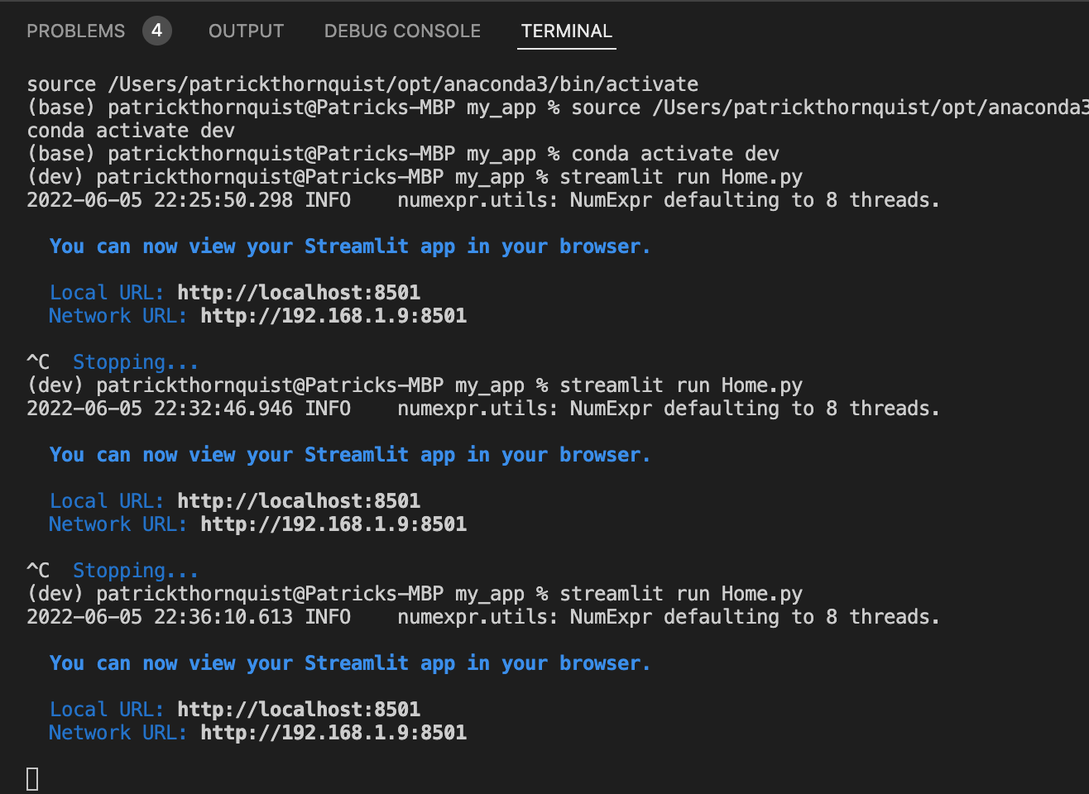
Testing
We constantly stopped and re-ran Streamlit as we tested functionality.
To confirm that the Solidity code/contracts were working properly, we also used the Remix Deploy tab to test out calls and transacts.

Slide 6
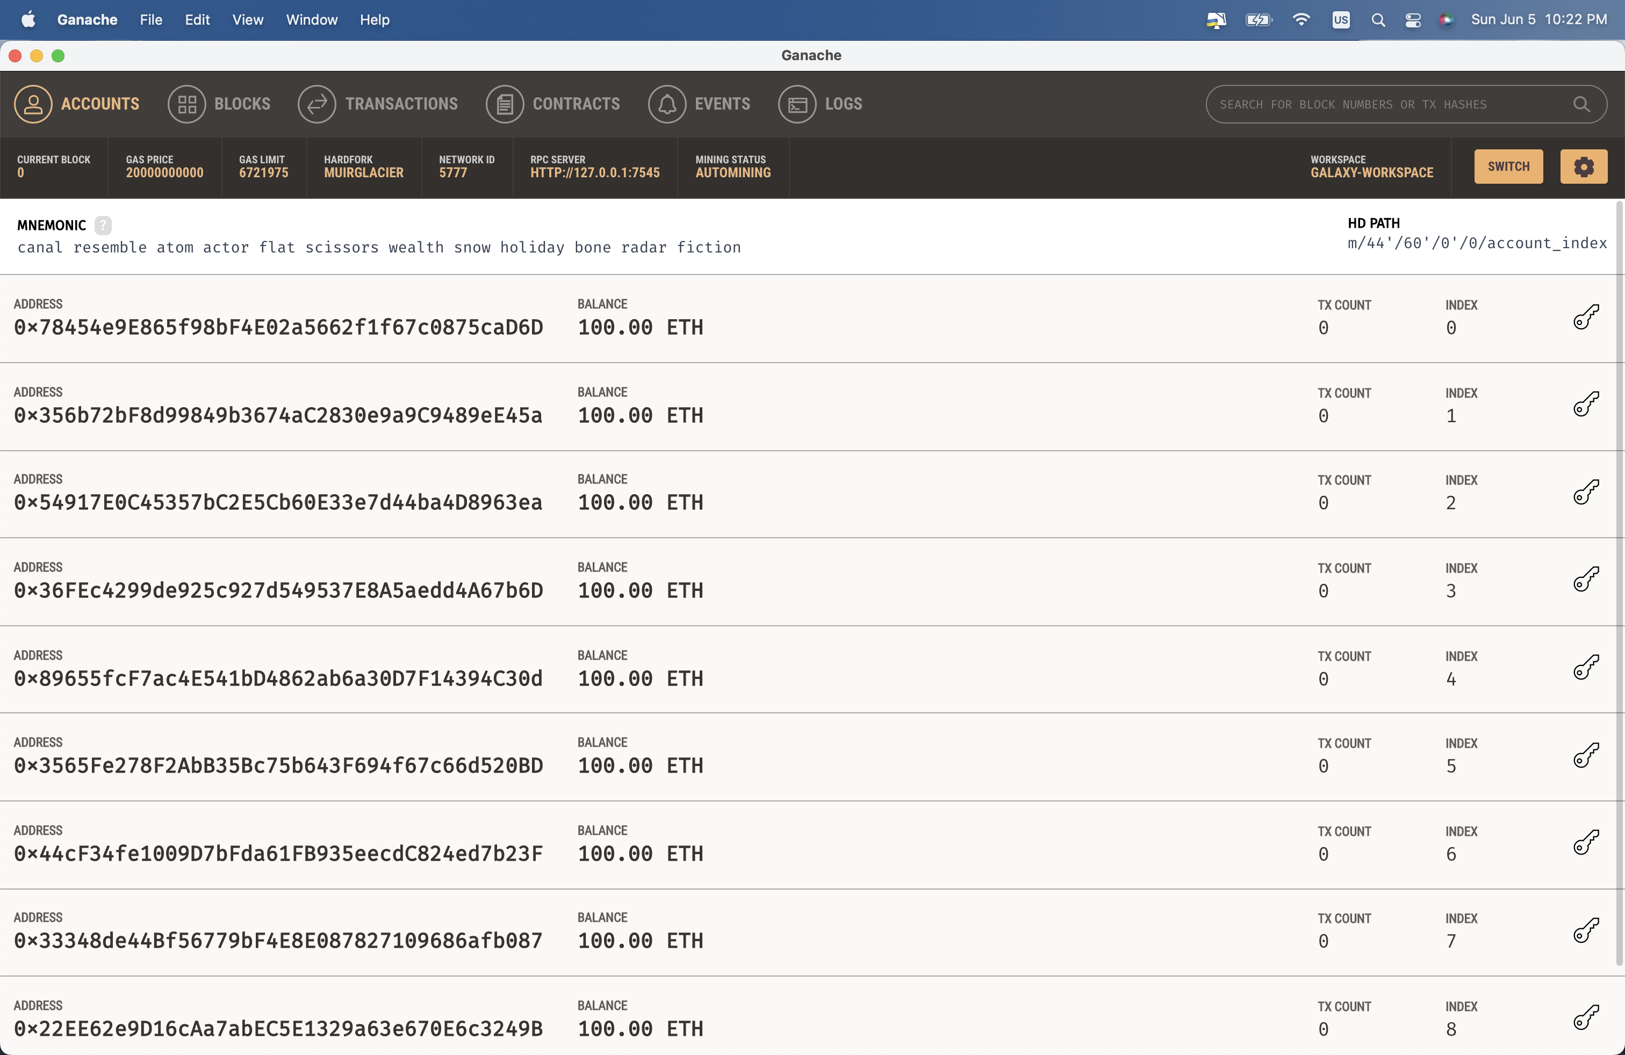
Testing (cont.)
To test on a simulated blockchain, we used Ganache.
We connected Remix to Ganache through MetaMask with Injected Web3.

Slide 7
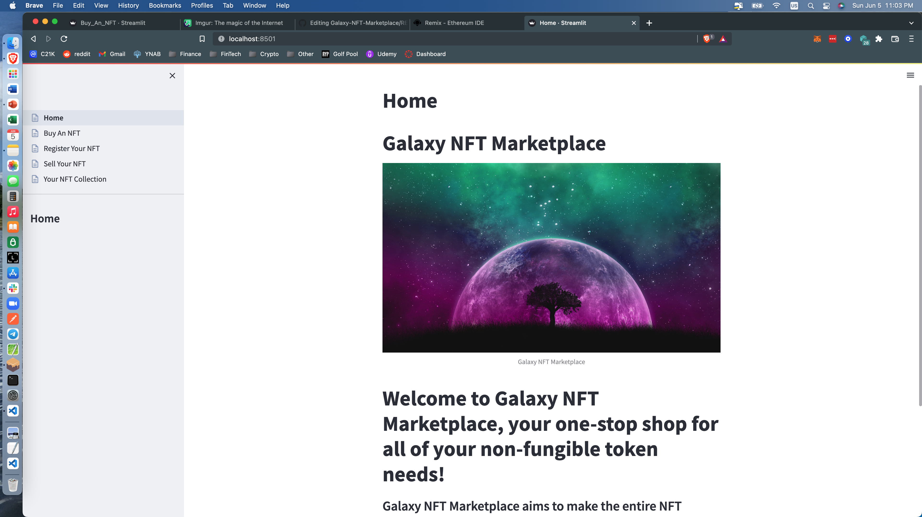
Home Page

Slide 8
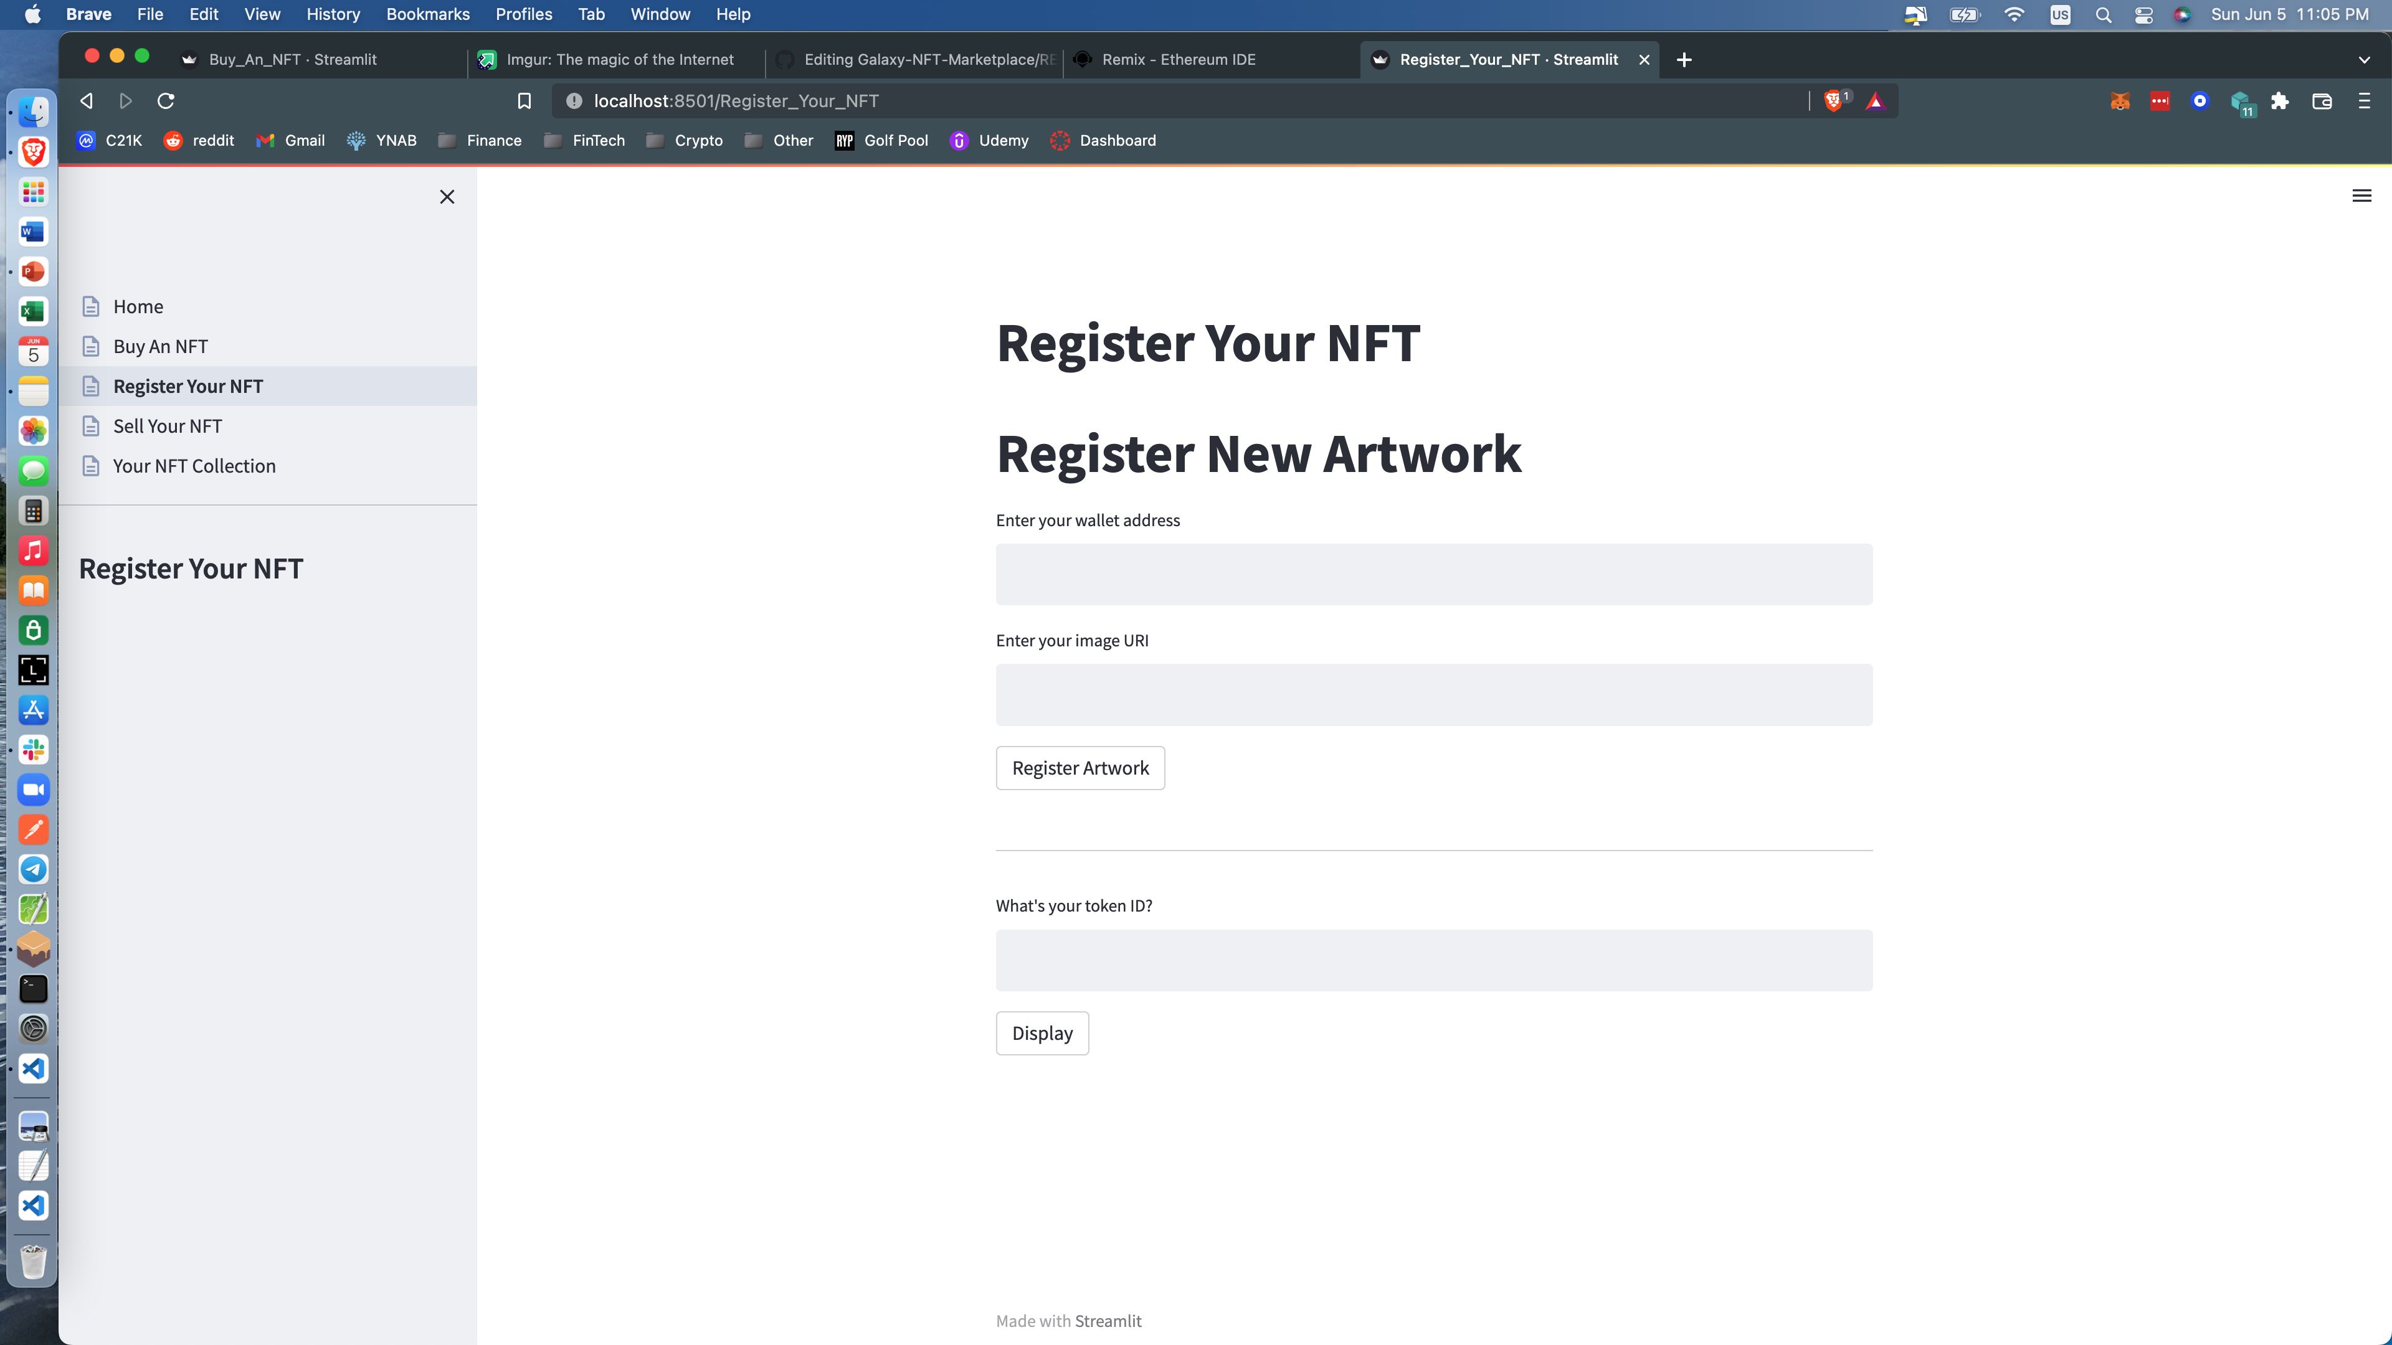
Register Your NFT

Slide 9
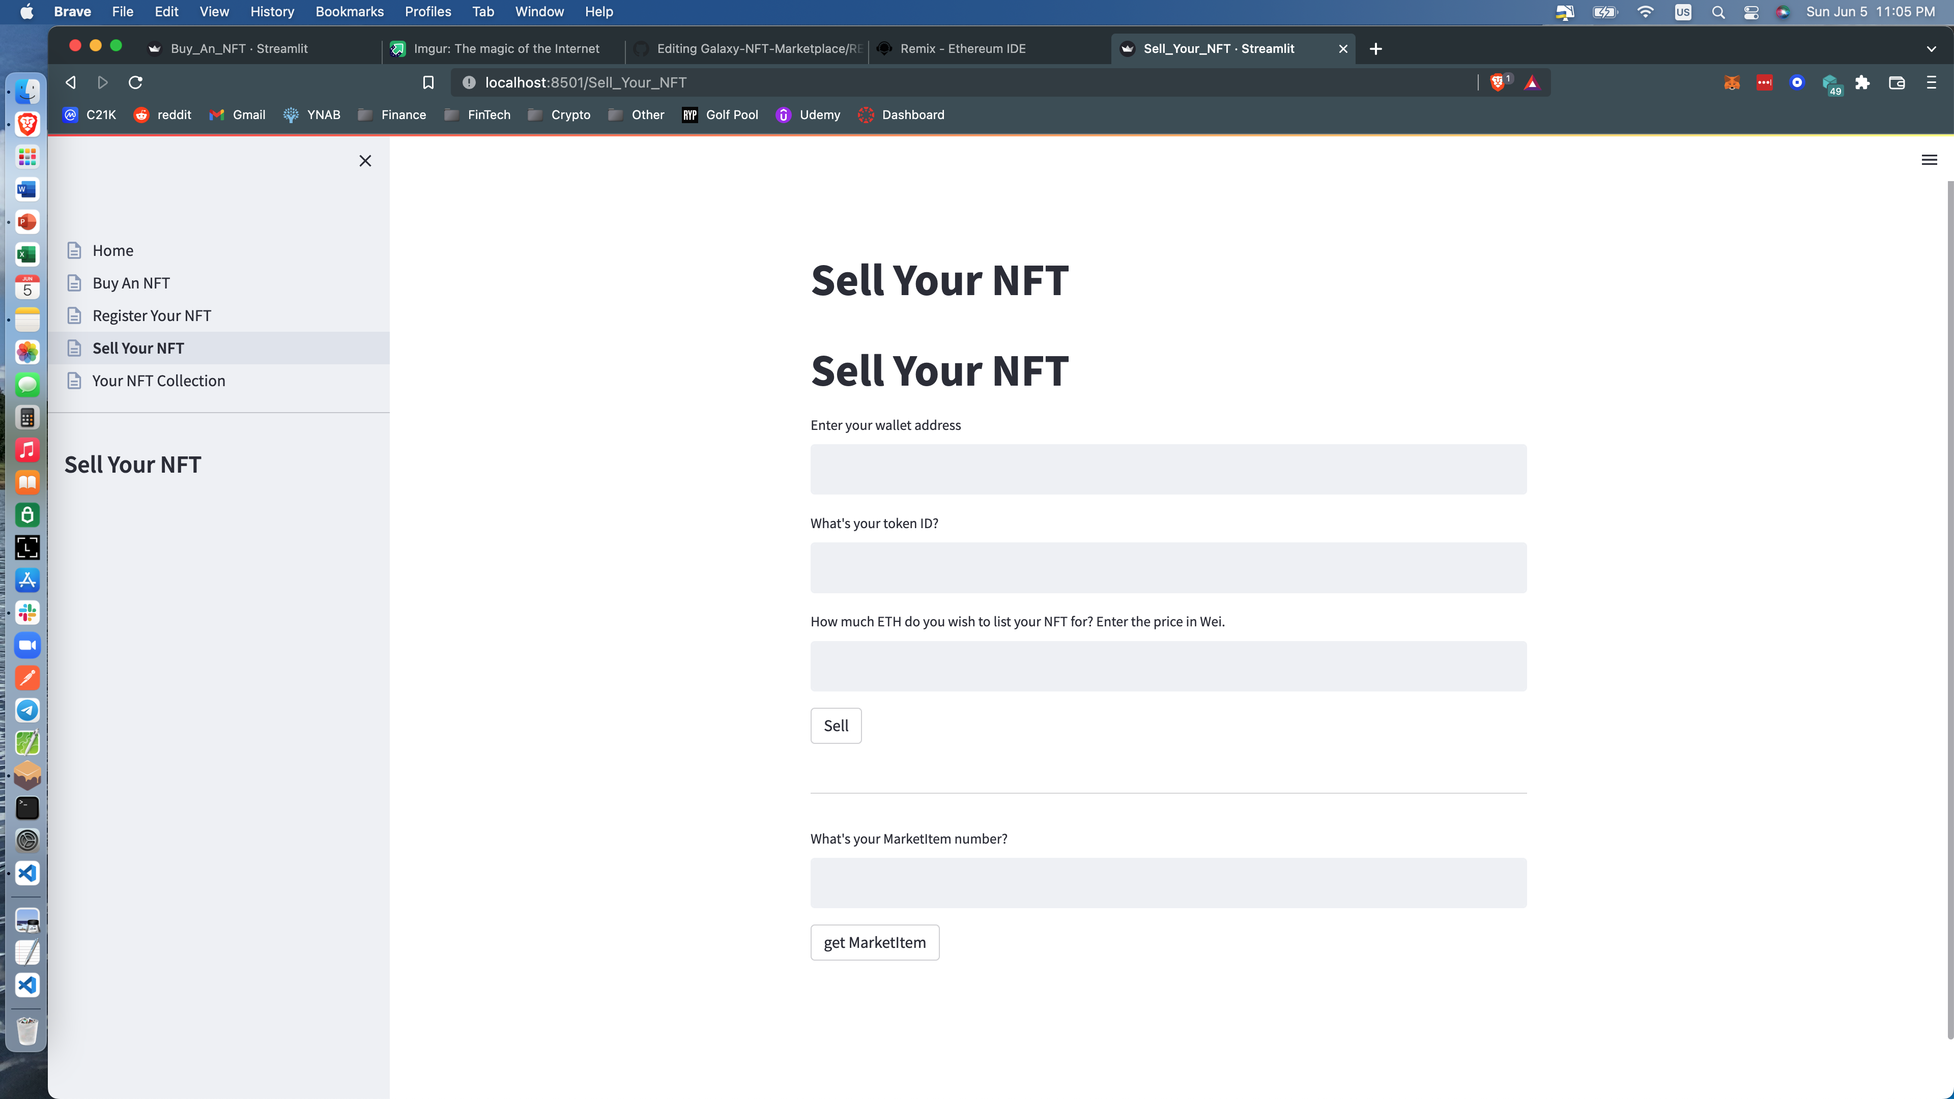
Sell Your NFT

Slide 10
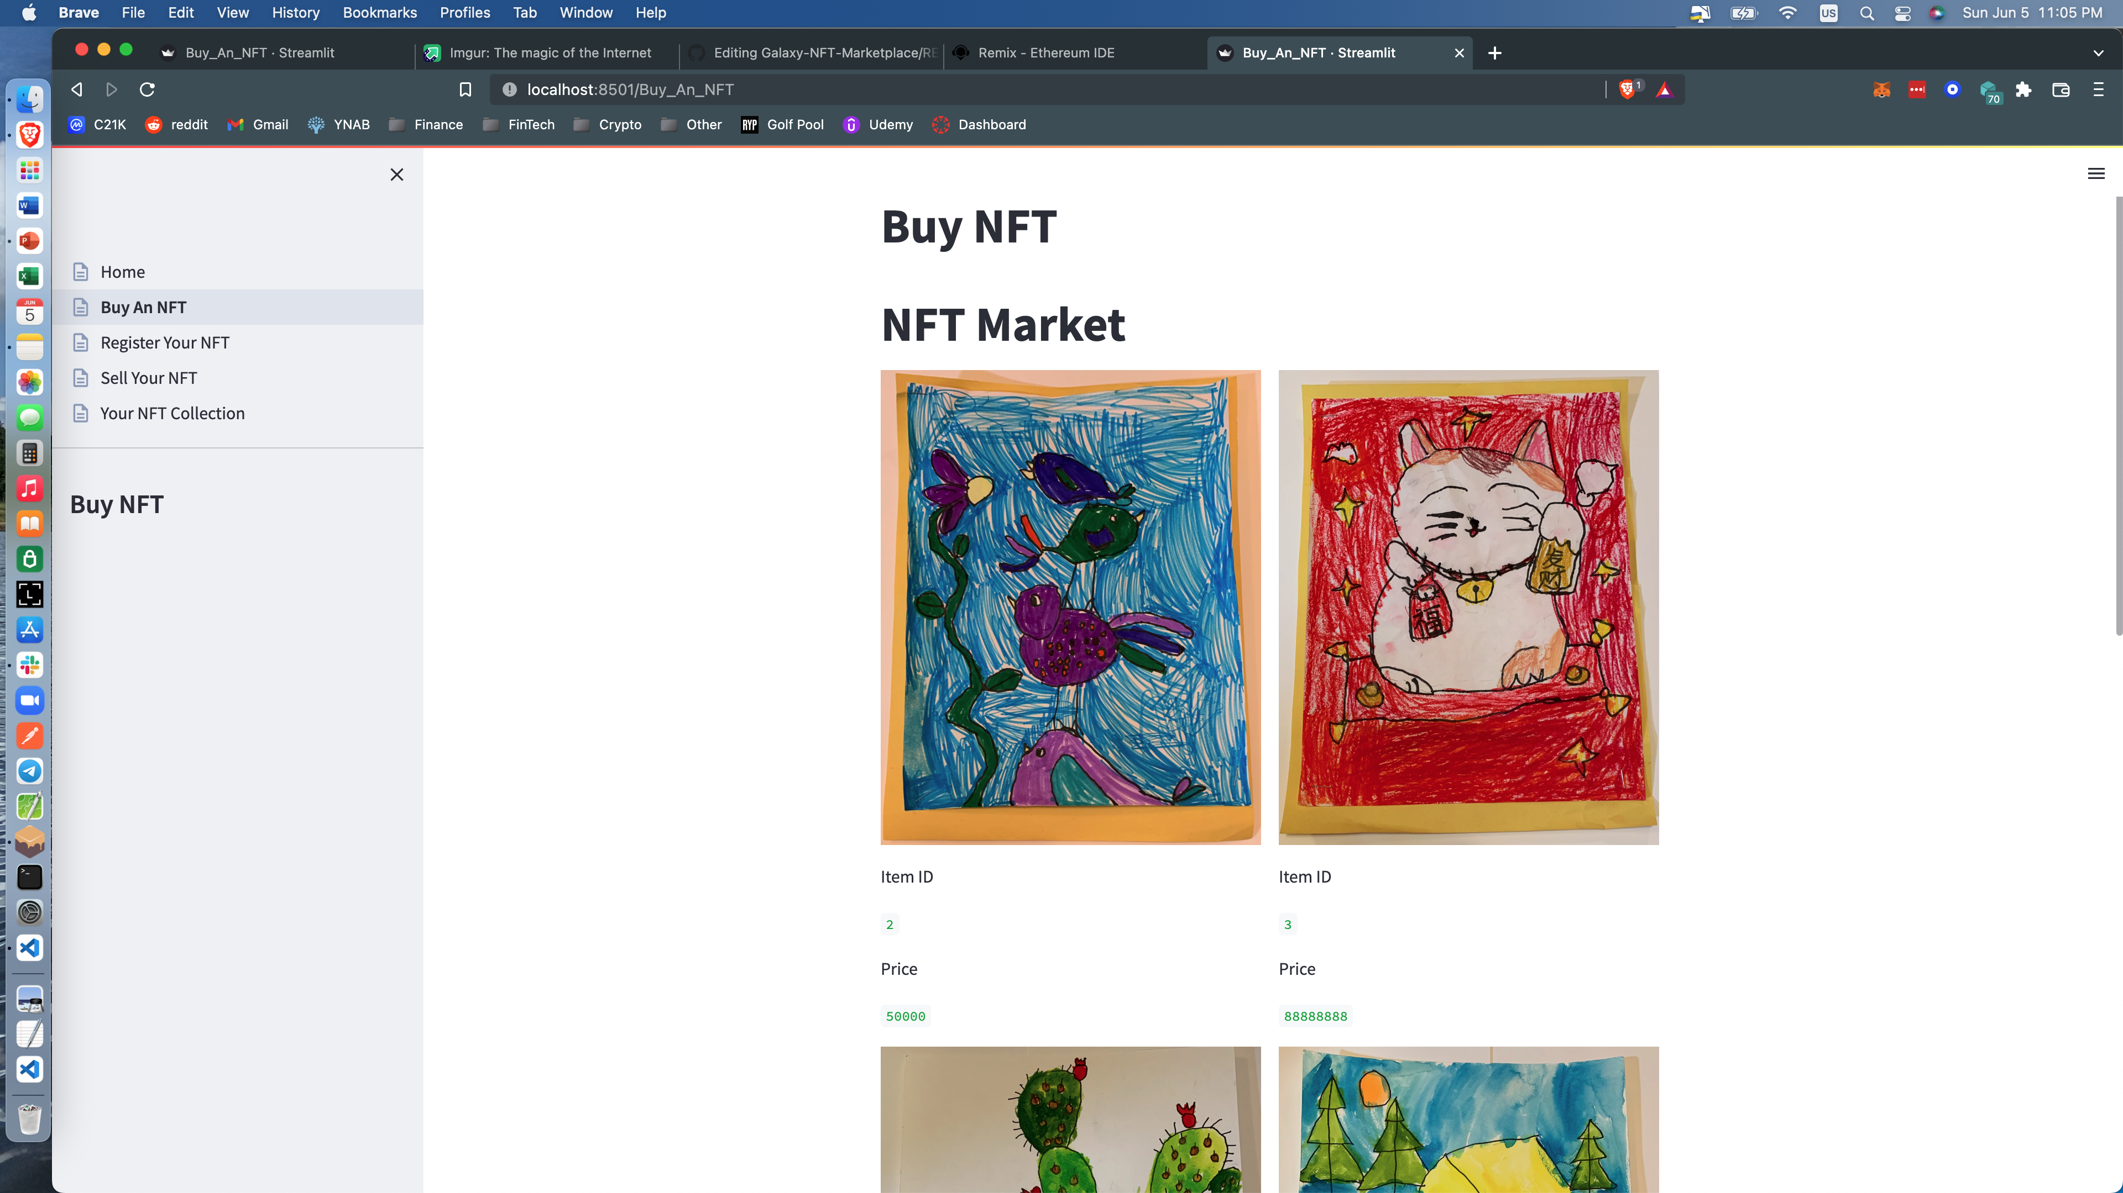
Buy An NFT

Slide 11
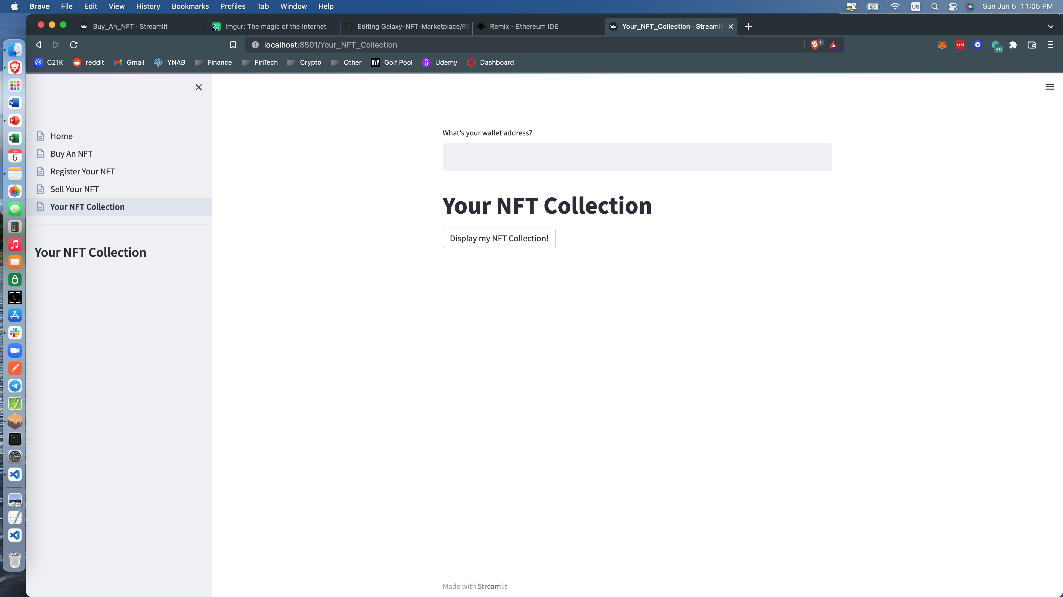
Your NFT Collection

Slide 12
Demonstration!

Slide 13
Conclusion
We truly enjoyed this project! It was fun to work through problems and also change the plan when needed to ensure we could reach our goal of having a working product.

Slide 14
Next Steps
In the future, we would like to continue to provide more options for information and metadata on the NFTs in our marketplace.
Figuring out how to successfully launch and integrate our own ERC20 token, Galaxy Coin, is also a future goal.
The final plan is to launch this app using React and Node.js, while also enabling Web3 wallet functionality with MetaMask. We would first use a testnet such as Rinkeby, then head onto the mainnet.

